Slide 1

Optimizing Gym Utilization for GoodLife Fitness

Slide 2
Introduction
GoodLife Fitness, a leading fitness club chain in Canada, aims to enhance gym utilization and maximize client satisfaction. They face two key challenges: optimizing the attendance of their group fitness classes and managing gym equipment utilization.
By leveraging data and machine learning, GoodLife seeks to predict class attendance and gym crowd levels, ensuring better space availability and reducing overcrowding. This will lead to improved client experiences and increased profitability.

Slide 3
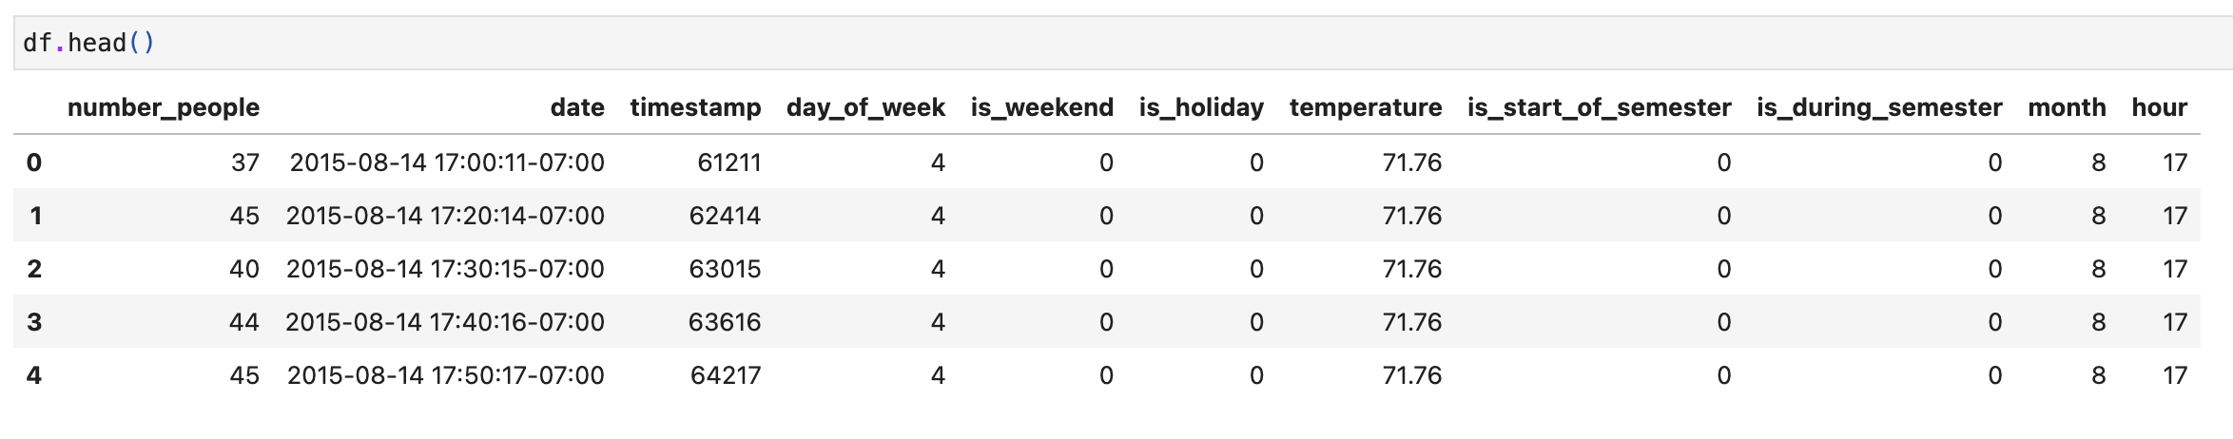
A. Optimizing Group Fitness Class Utilization:
GoodLife Fitness wants to improve the utilization of their group fitness classes, which often have low attendance despite being fully booked. By predicting whether members will attend their booked classes using member booking data, we can increase the number of available spaces and reduce no-shows. This will help improve class availability and attendance rates, boosting client satisfaction and profitability.

Slide 4
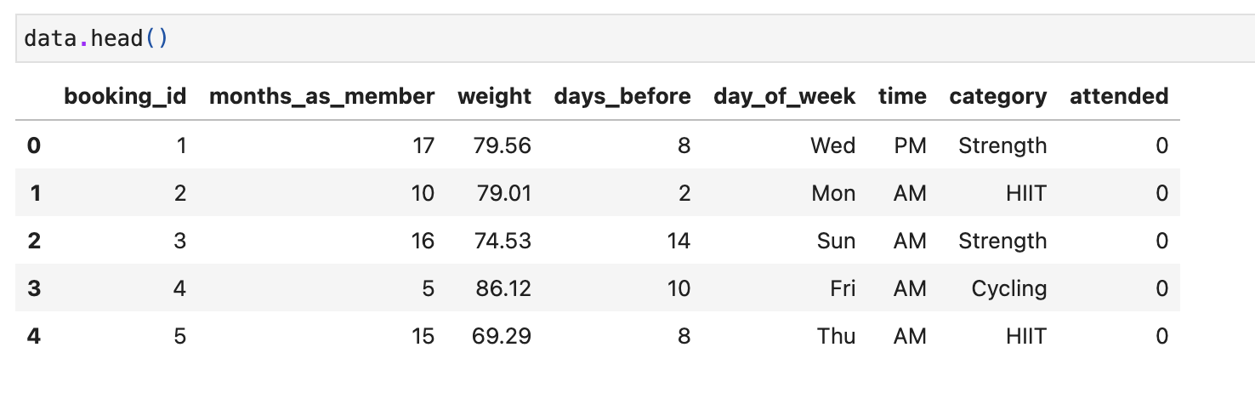
Problem B: Optimizing Gym Equipment Utilization
To manage gym crowd levels and optimize equipment usage, GoodLife Fitness seeks to predict how crowded the gym will be at various times. By analyzing data on gym attendance, weather conditions, and semester schedules, we will build a model to forecast gym occupancy. This will enable GoodLife to encourage members to use the facilities during less crowded times, ensuring better distribution of gym usage and enhancing the overall client experience.

Slide 5
Workflow
Data Cleaning and Exploratory Data Analysis
Feature Engineering
Model Training
Model Evaluation
Prediction Comparison and Conclusion

Slide 6

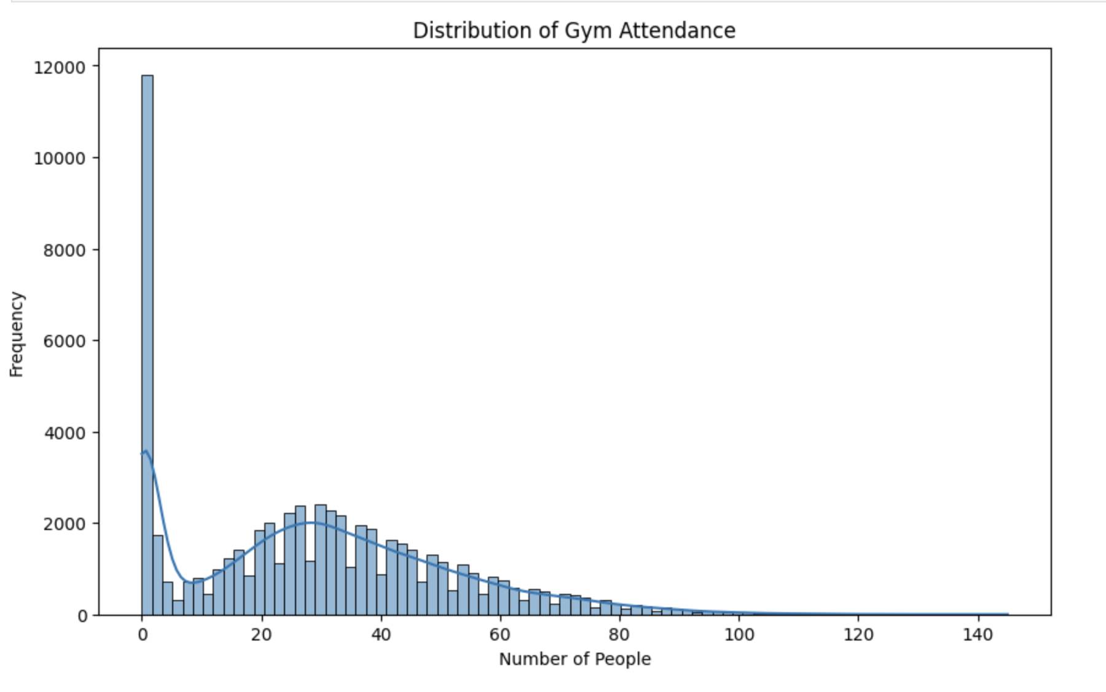
Problem A - Visualization:
Most gym classes have very low or zero attendance, despite being fully booked. Higher attendance classes are significantly less frequent, indicating a need for better prediction and management of class attendance.

Slide 7

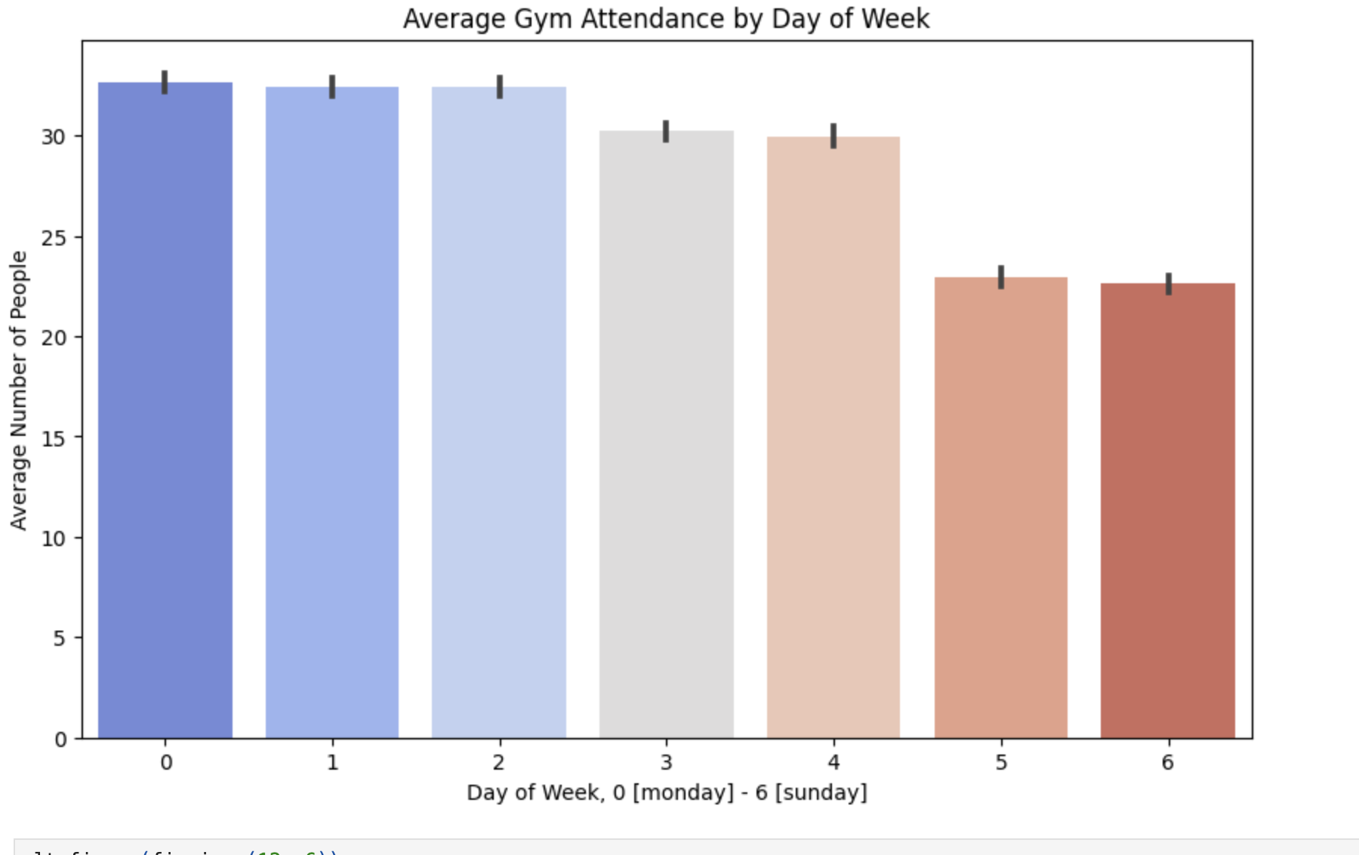
Average Gym Attendance by Day of Week
Gym attendance is highest on Mondays, Tuesdays, and Wednesdays.
Attendance drops significantly on weekends, particularly on Sundays.
These trends can inform scheduling and promotion strategies to balance gym usage throughout the week.

Slide 8
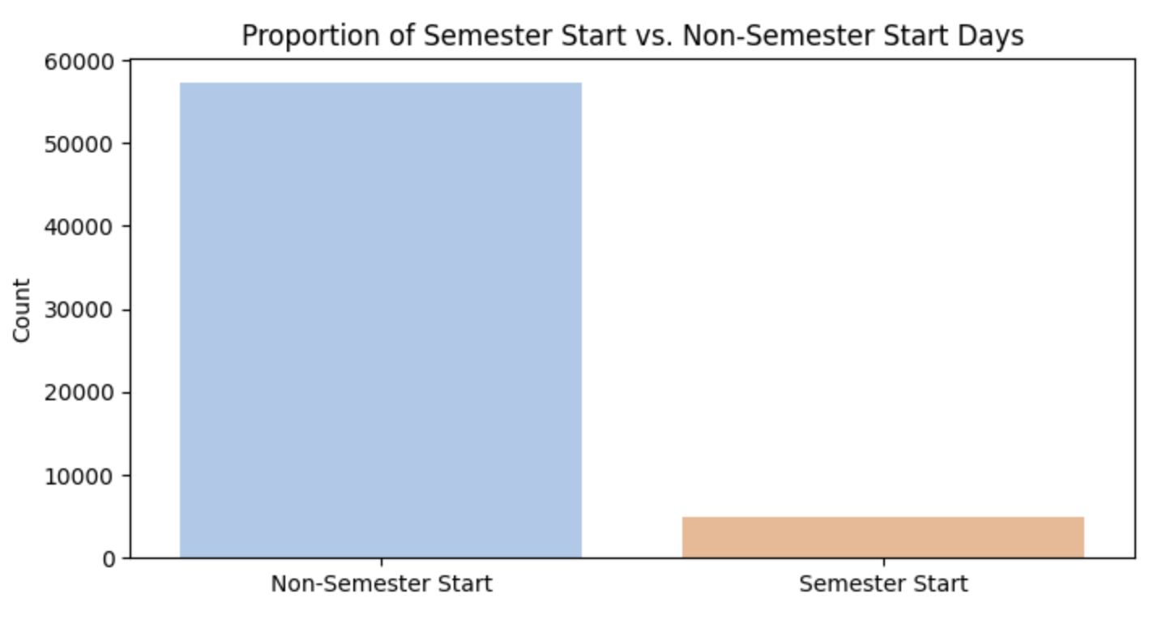
Proportion of Semester Start vs. Non-Semester Start Days
The majority of the data points are from non-semester start days, with significantly fewer data points from semester start days.
This suggests that the start of a semester is a relatively infrequent event compared to regular days.
Understanding this proportion helps in accurately predicting gym attendance patterns around the semester start period.

Slide 9
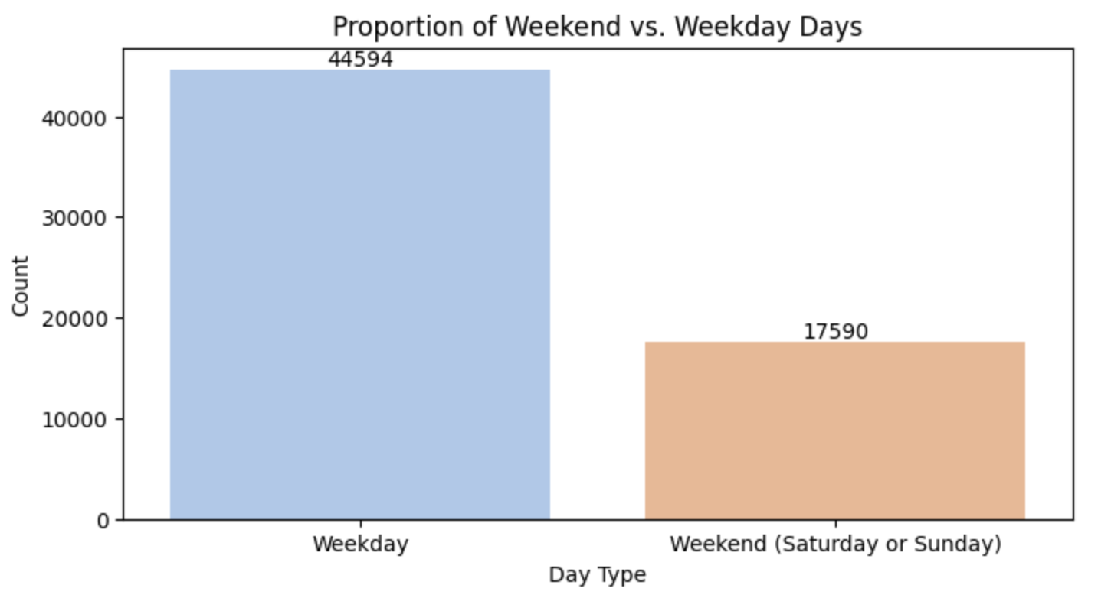
Data Distribution by Day of Week
Weekdays dominate data points with 44,594 observations.
Weekends show significantly fewer data points at 17,590.
This indicates a clear pattern of higher activity on weekdays.

Slide 10
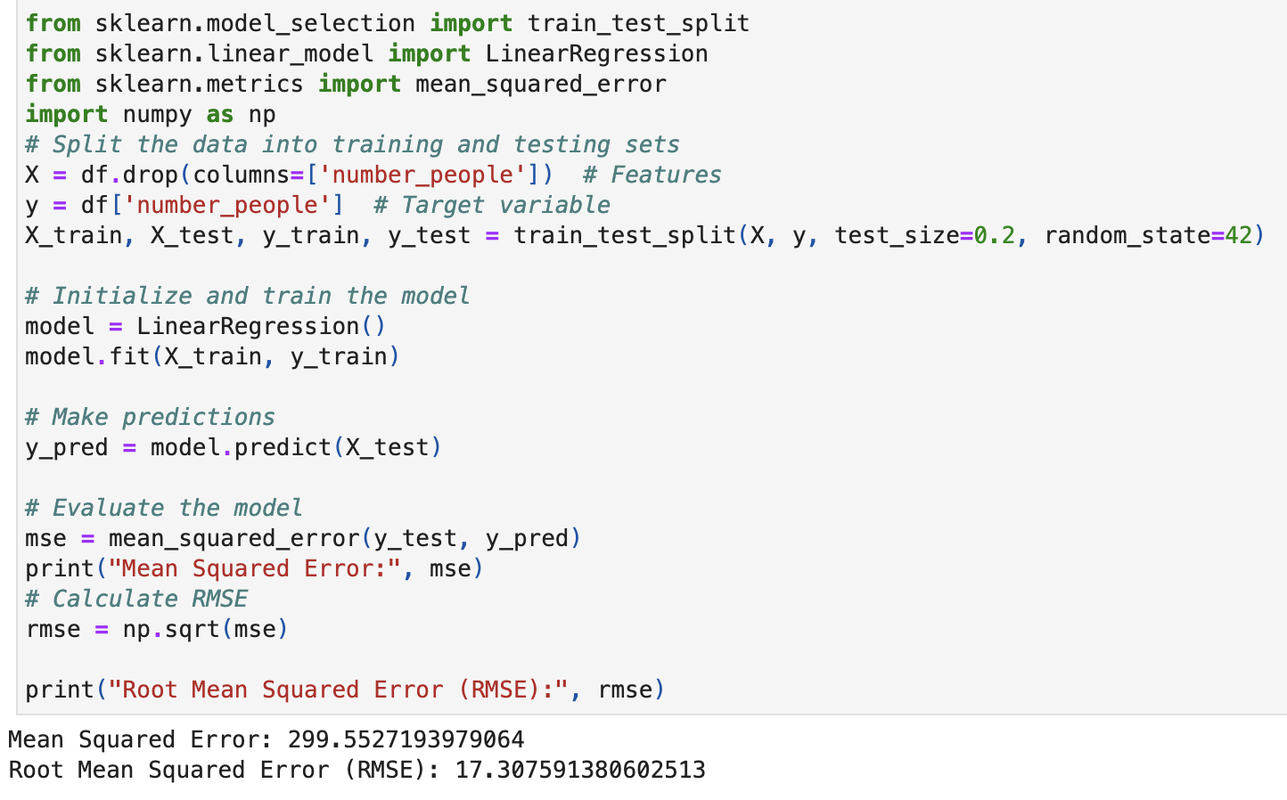
Problem A – Model Evaluation
Linear Regression Model: Used to predict the number of people.
Mean Squared Error (MSE): 299.55, indicating the average squared difference between predicted and actual values.
Root Mean Squared Error (RMSE): 17.31, representing the average deviation between predicted and actual values.
Evaluation: The model's performance, as measured by MSE and RMSE, suggests room for improvement in prediction accuracy.

Slide 11
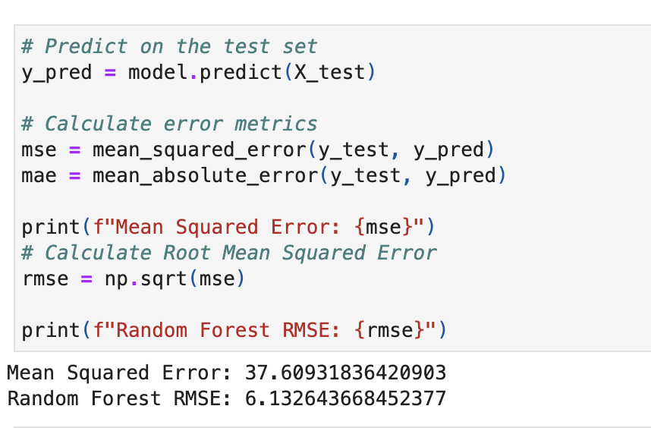
Problem A – Model Evaluation
Random Forest Model: Used to predict the number of people.
Mean Squared Error (MSE): 37.61, indicating the average squared difference between predicted and actual values.
Root Mean Squared Error (RMSE): 6.13, representing the average deviation between predicted and actual values.
Evaluation: The model's performance, as measured by MSE and RMSE, suggests a reasonable level of accuracy in predicting the number of people.

Slide 12
Problem A – Prediction Comparison
Mean Squared Error (MSE): Random Forest has a significantly lower MSE (37.61) compared to Linear Regression (299.55), indicating that Random Forest makes more accurate predictions on average.
Root Mean Squared Error (RMSE): Similarly, Random Forest has a lower RMSE (6.13) than Linear Regression (17.31), further confirming its better performance in terms of prediction accuracy.
Evaluation: The Random Forest model demonstrates superior performance in predicting the number of people compared to the Linear Regression model, as evidenced by lower MSE and RMSE values. This suggests that Random Forest is a more suitable model for this prediction task.

Slide 13
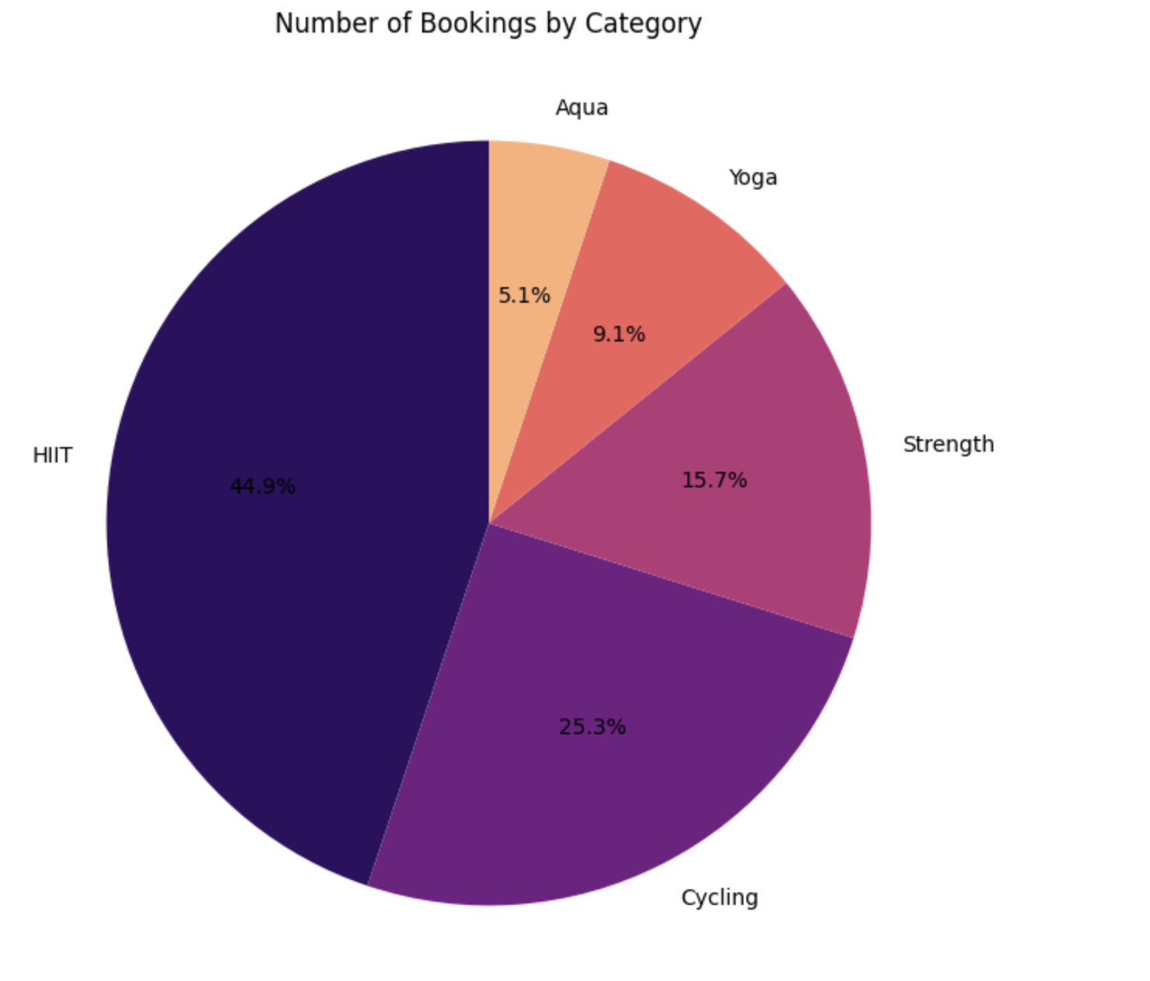
Problem B –Visualization
Number of Bookings by Category
HIIT is the most popular category with 44.9% of bookings.
Cycling and Strength are the second and third most popular categories with 25.3% and 15.7% of bookings, respectively.
Yoga and Aqua are the least popular categories with 9.1% and 5.1% of bookings, respectively.

Slide 14
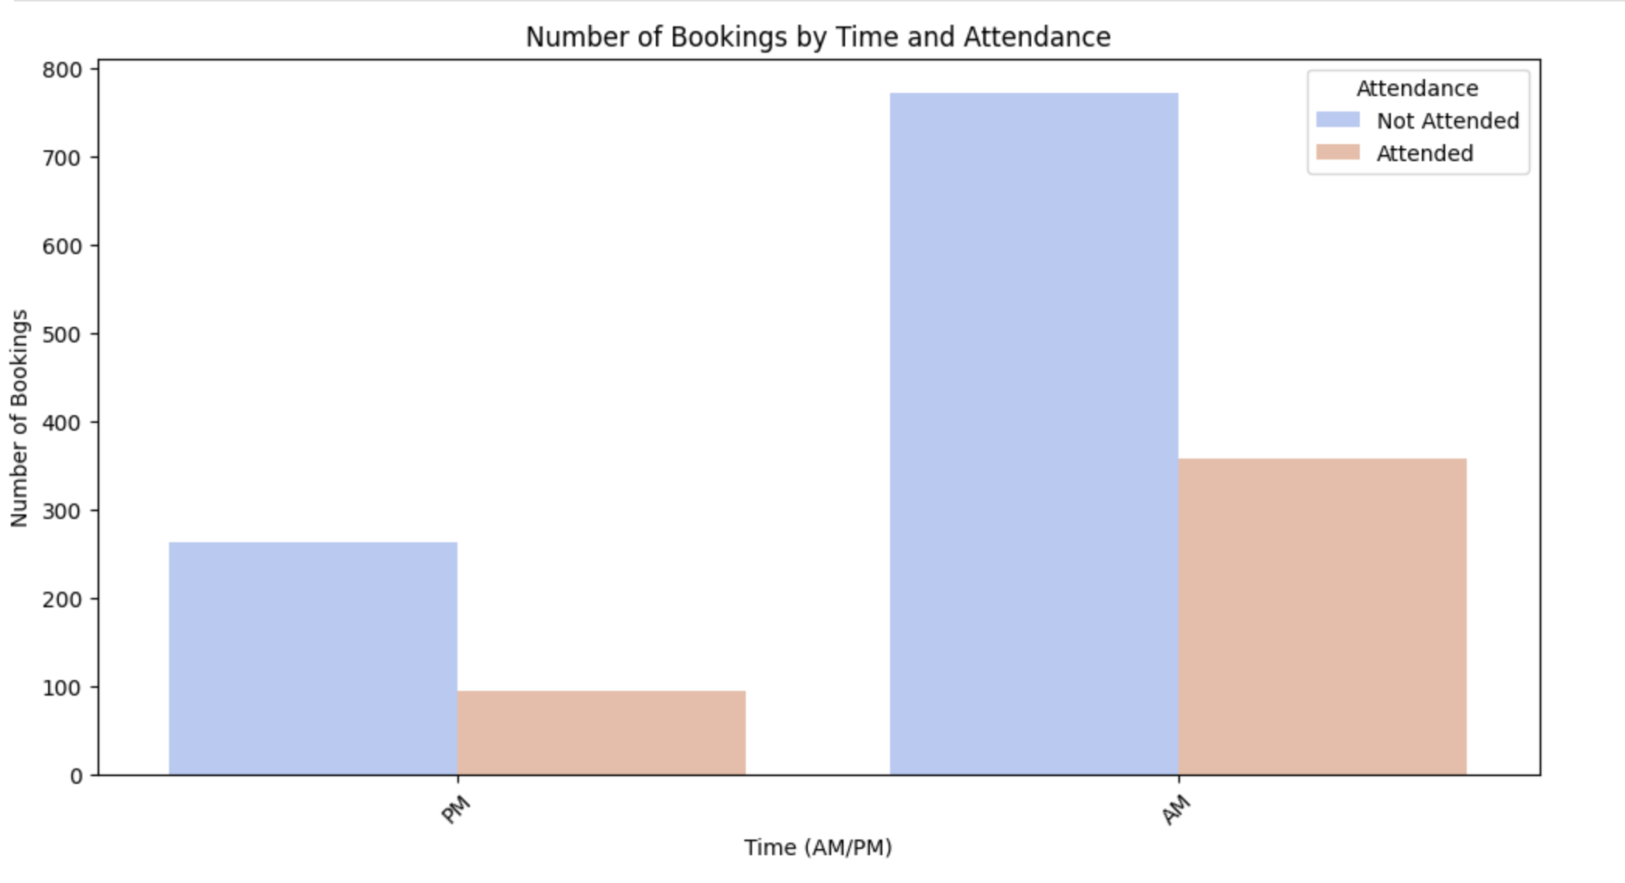
Problem B- Plots :
AM classes have significantly higher total bookings compared to PM classes.
AM classes have a higher number of both attended and not attended bookings.
The proportion of attended bookings to total bookings is similar for both AM and PM classes.

Slide 15

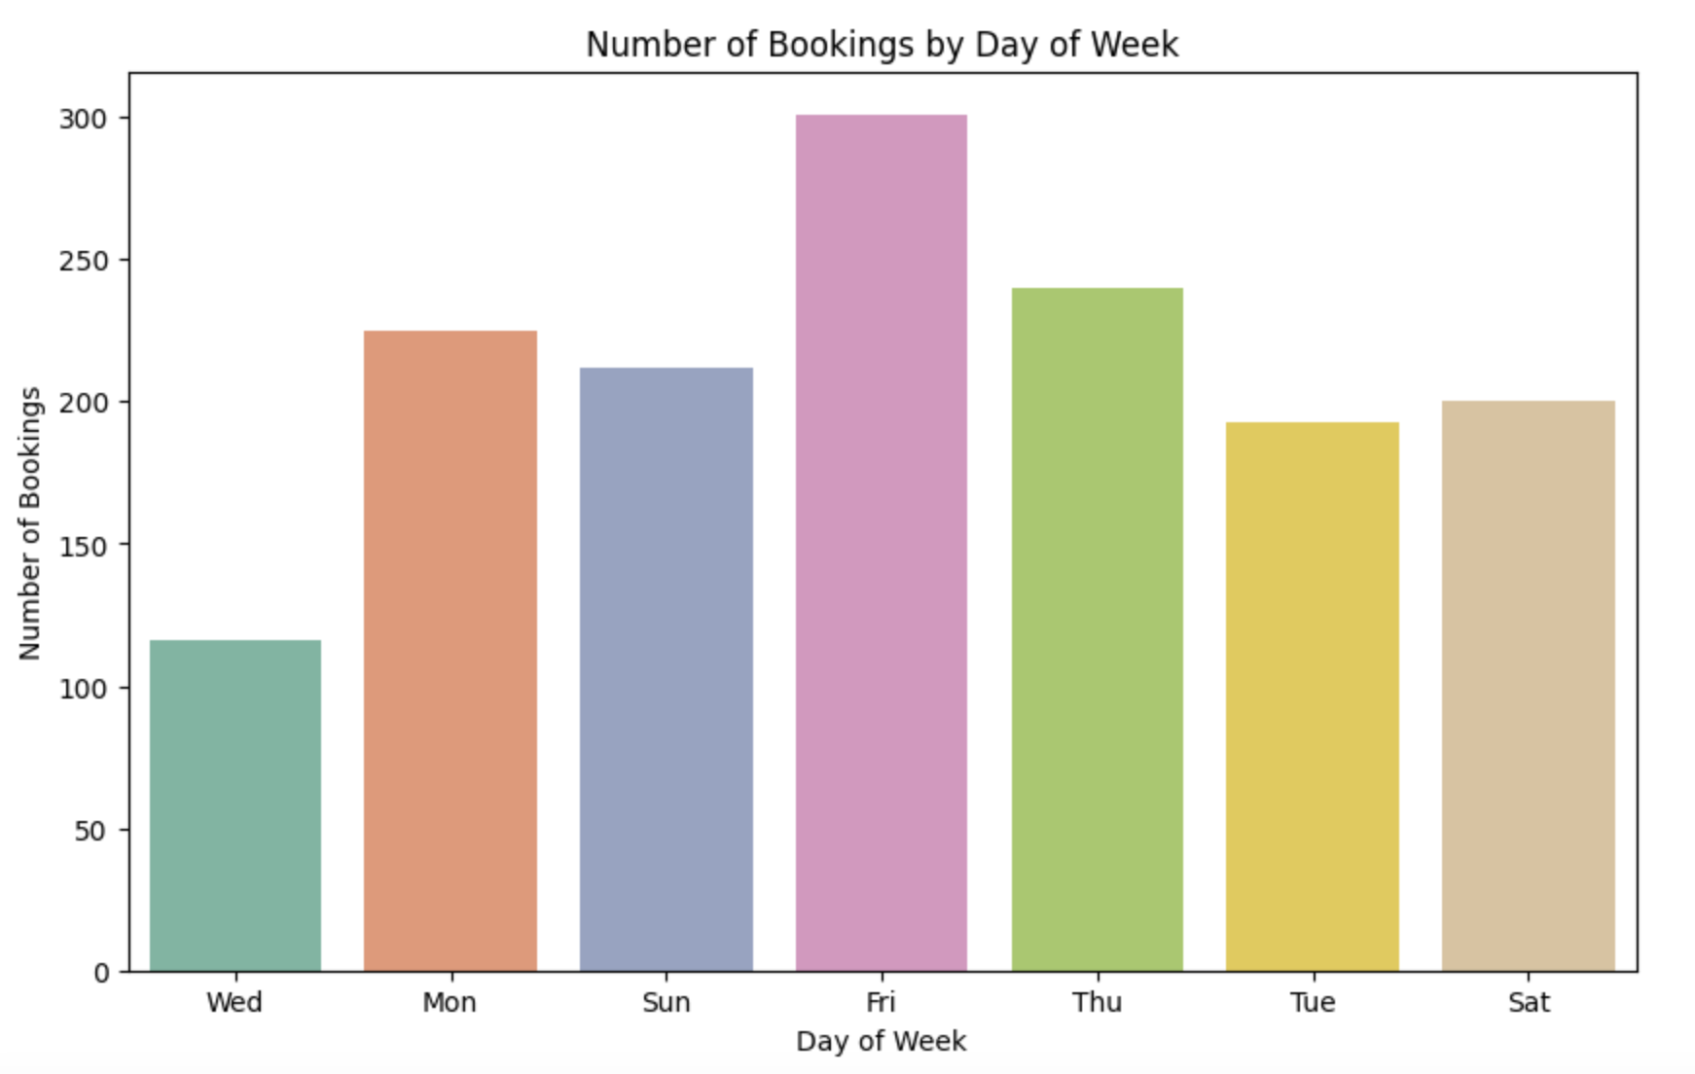
Booking Distribution by Day of Week
Friday has the highest number of bookings.
Wednesday has the lowest number of bookings.
Booking numbers are relatively consistent from Monday to Saturday.

Slide 16

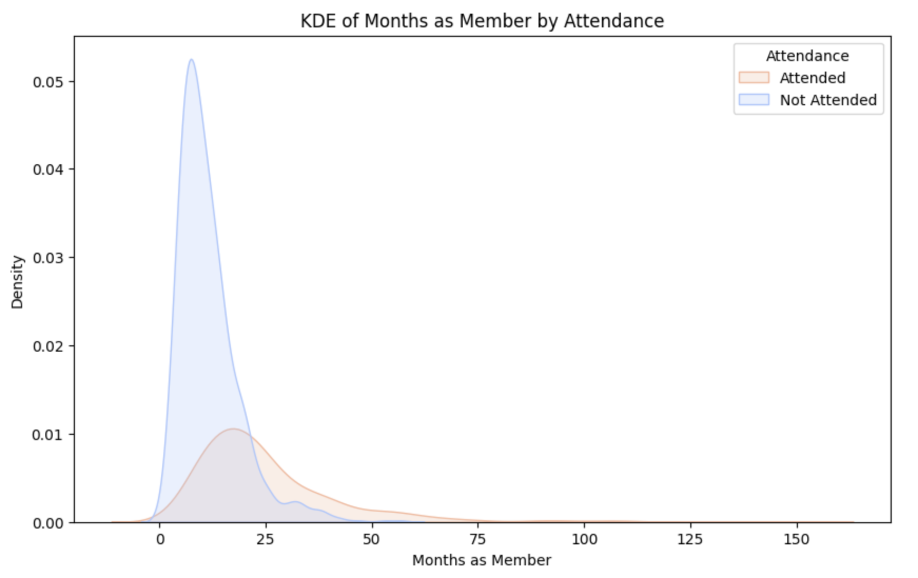
Problem B - Impact of Membership Duration on Class Attendance
Members with longer memberships (more than 25 months) are more likely to attend classes.
There is a significant overlap between members who attend and do not attend classes, particularly within the first 25 months.
The distribution for those who do not attend classes is skewed towards the lower end, indicating a higher likelihood of non-attendance among newer members.

Slide 17
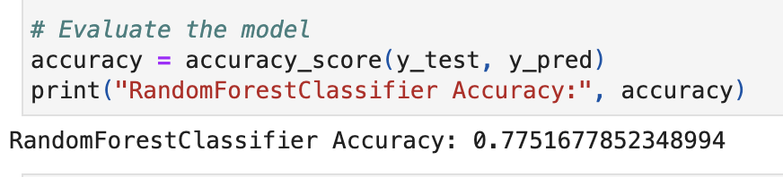
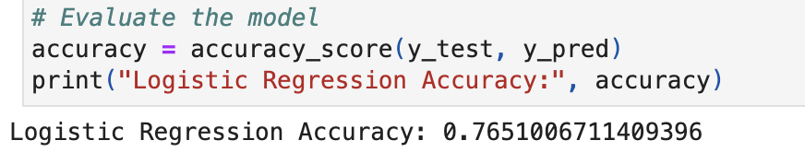
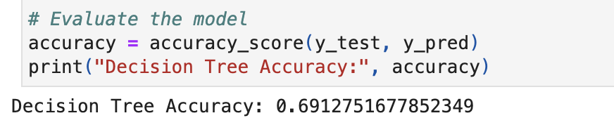
Problem B- Model Evaluation
Model Type: Random Forest, Logistic Regression, Decision Tree
Accuracy: Random Forest exhibits the highest accuracy at 77.52%, followed by Logistic Regression at 76.51%, and Decision Tree with the lowest accuracy at 69.13%.
Evaluation: The Random Forest model demonstrates superior performance in classifying the data compared to Logistic Regression and Decision Tree models.

Slide 18
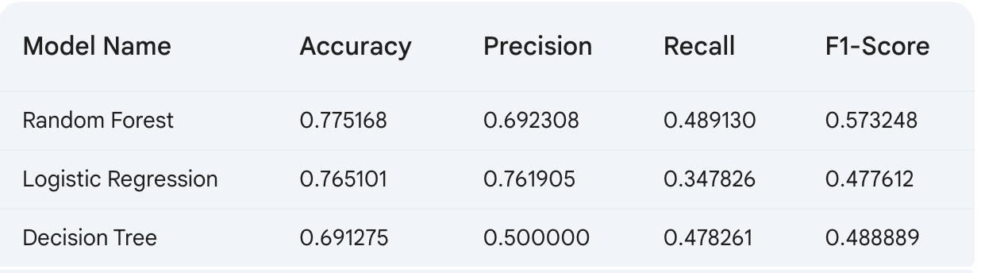
Problem B- Model Evaluation Comparison
Accuracy: Random Forest achieves the highest accuracy (0.775) among the three models, followed by Logistic Regression (0.765) and Decision Tree (0.691).
Precision: Logistic Regression has the highest precision (0.762), indicating a lower rate of false positives compared to Random Forest (0.692) and Decision Tree (0.500).
Recall: Random Forest has the highest recall (0.489), indicating it captures a larger proportion of relevant cases compared to Logistic Regression (0.348) and Decision Tree (0.478).
F1-Score: Random Forest again emerges as the best performer with the highest F1-score (0.573), which incorporates both precision and recall.
Overall: Random Forest demonstrates the most balanced performance across accuracy, precision, and recall metrics, making it the preferred model in this case

Slide 19
Conclusion
Problem A: Optimizing Gym Equipment Utilization
Accurate gym occupancy prediction can improve resource allocation and member experience.
Optimized equipment utilization can lead to increased revenue and customer satisfaction.
Problem B: Optimizing Group Fitness Class Utilization
Predicting class attendance helps optimize class schedules and improve member satisfaction.
Maximizing class utilization contributes to increased revenue and gym profitability.

Slide 20
Market Analysis
Problem A: Optimizing Gym Equipment Utilization
Analyse competitor gym occupancy to identify competitive advantages.
Explore new technologies to enhance gym utilization.
Problem B: Optimizing Group Fitness Class Utilization
Analyse competitor class offerings to identify market gaps.
Understand member preferences to develop attractive class options.

Slide 21
Thank You

